Slide 1

PINN Papers Summary
Jiwon Kang
MS-PhD Program of Mechanical Engineering
Seoul National University, South Korea

Slide 2
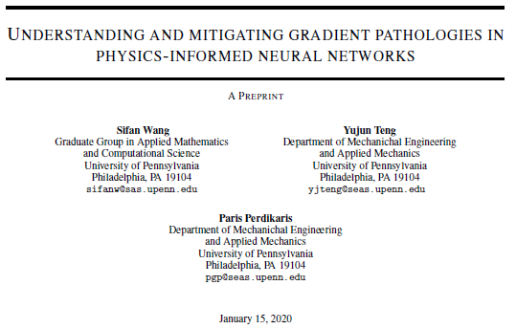
1. Mitigating Gradeint

Slide 3
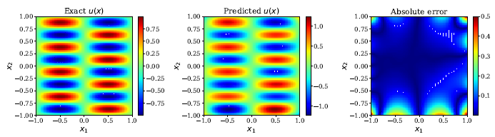
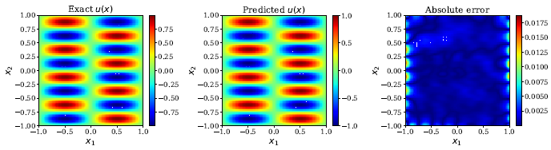
Main Idea
Inaccurate around boundary conditions
1. Mitigating Gradeint
Training failure of
Previous PINNs
Learning rate annealing algorithm
Novel Neural Architecture
Solve Unbalanced
back propagation gradients

Slide 4



Methodology
Gradient Imbalance in PINN
With previous loss function
1. Mitigating Gradeint
If we assume
Proof omitted
large imbalance between
residual loss gradient/ boundary loss gradient
when C is large

Slide 5




Methodology
Stability analysis in PINN
1. Mitigating Gradeint
Representation
In Hessian
With large
eigenvalues
Fail to decrease the loss
even in the right direction
Current PINN’s gradient descent
can be a poor choice for training

Slide 6






Methodology
Learning rate Annealing algorithm
1. Mitigating Gradeint
Current PINN parameter update
Loss with regularization parameter
Learning rate Annealing algorithm
Balance the gradient values between
Residual point loss and IC/BC point loss
Algorithm to choose parameters

Slide 7
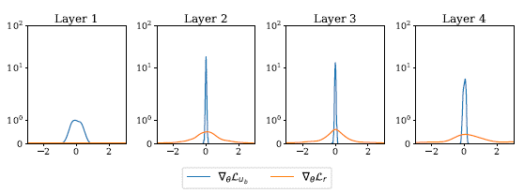
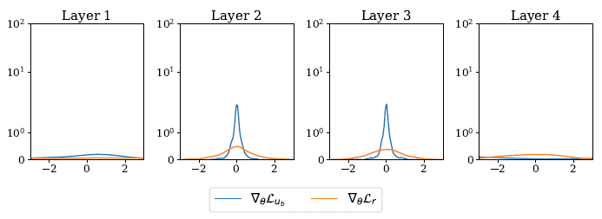
Methodology
Learning rate Annealing algorithm
1. Mitigating Gradeint
Previous PINN
Boundary loss gradient is almost zero
from the second layer.
Enhanced PINN
The discrepancy between residual and
BC/IC loss gradient has reduced.

Slide 8
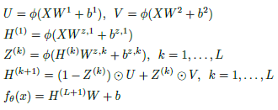
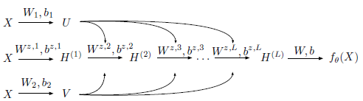
Methodology
Improved Neural Architecture
1. Mitigating Gradeint
Inspired by Attention mechanism
and Residual Connection structure
From only using shallow fully connected networks,
Papers with Various approaches
of using diverse DNN networks

Slide 9

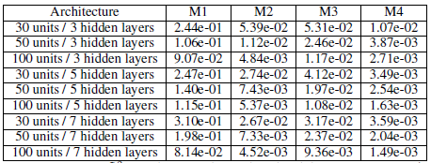
Example Case: Helmholtz equation
1. Mitigating Gradeint
M1: previous PINN
M2: learning rate annealing
M3: novel Neural network
M4: both
M4 shows much less error compared to M1.

Slide 10

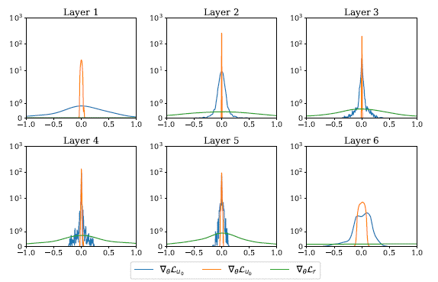
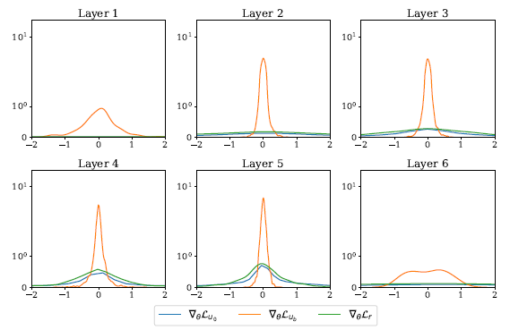
Example Case: Klein Gordon equation
1. Mitigating Gradeint
M2 shows less discrepancy between the gradients compared to M1.

Slide 11
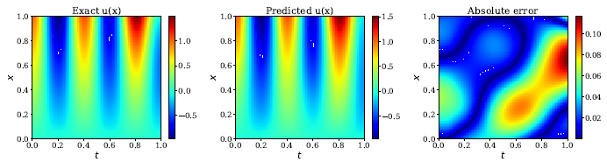
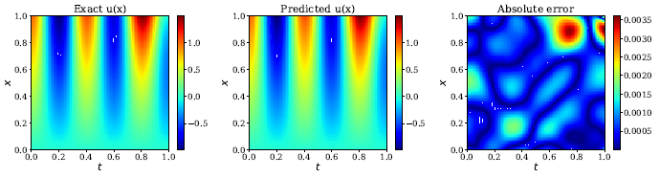
Example Case: Klein Gordon equation
1. Mitigating Gradeint
M3 shows better performance compared to M1.

Slide 12
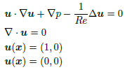
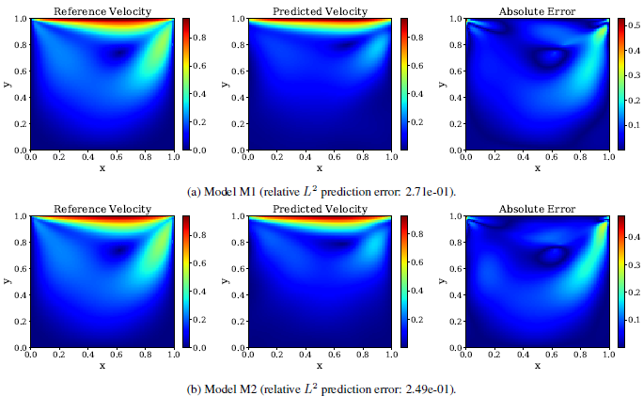
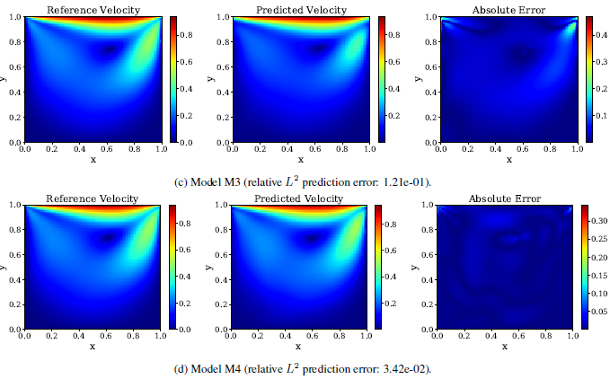
Example Case: Flow in a lid driven cavity
1. Mitigating Gradeint
M4(right bottom corner) shows better performance compared to M1(left up corner)

Slide 13
Pros and Cons
Pros
More stable gradient flow system
1. Mitigating Gradeint
Cons
Increase of computational cost
Different hyper-parameters for different dataset
Future Outlook
PINN papers are starting to apply various DNN structures such as GANs, Attention, ResNet and so on.
One of the main problems of PINN is the lack of dataset. There has been one paper applying generative models
to PINN and planning to take that as a start point.

